Slide 1
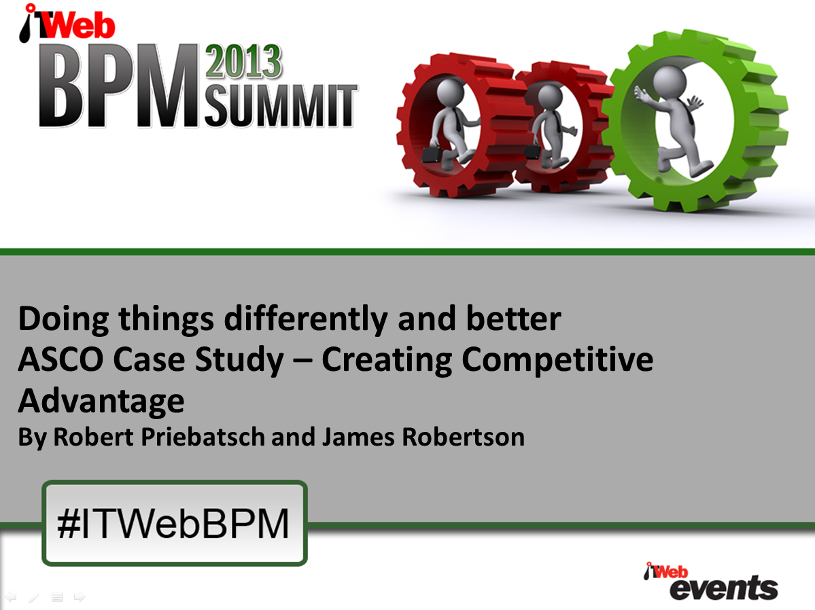

Slide 2
Agenda
ASCO Case Study – Creating Competitive Advantage
Overview of the business
The challenge – overview of the situation before the investment
The opportunity – implementing a new ERP and Warehouse System taking a strategic view
The solution – highly structured Product Class, integration with Projects Module, custom software
The outcome – greatly improved brand management and other capabilities supporting profitable growth and competitiveness

Slide 3
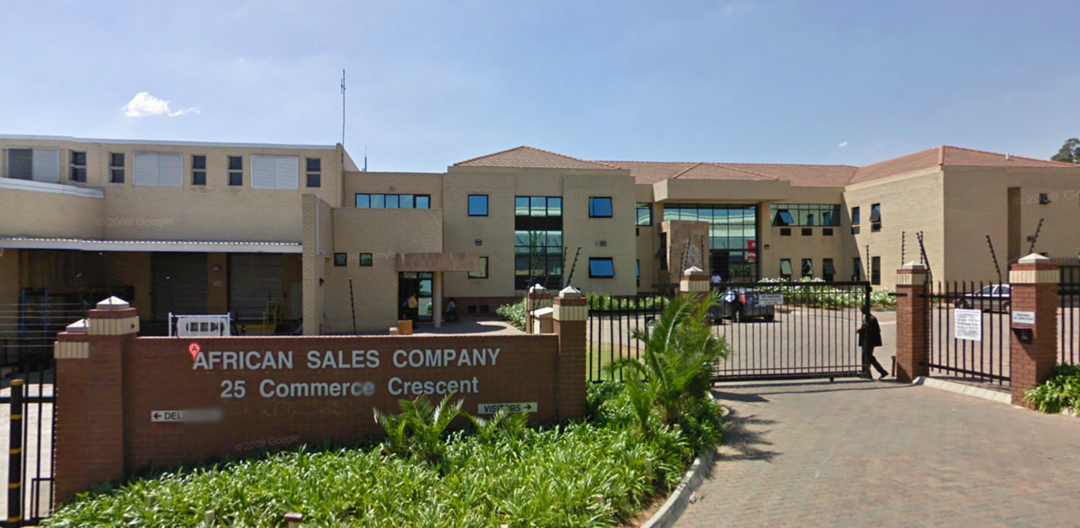
Agenda
ASCO Case Study – Creating Competitive Advantage
Overview of the business

Slide 4

Overview of the business
Moderate size
Family owned
Imports and distributes fine fragrances and luxury cosmetic brands like Dior, Givenchy, Gucci, Dolce and Gabbana, Paco Rabanne, Carolina Herrera, Prada, Calvin Klein, Hugo Boss and others
To retail vendors like Edgars, Foschini, Truworths, Stuttafords, Woolworths, Dis-Chem and others
Prescribed service levels
Also provides a Brand Management Service closely allied with the distribution side of the business

Slide 5
Agenda
ASCO Case Study – Creating Competitive Advantage
Overview of the business
The challenge – overview of the situation before the investment

Slide 6
The Challenge
Old customized software grown with tight budget
Brand related costs managed with over 20,000 accounts in the General Ledger
Other aspects of Brand Management were manual
Tracking costs and reporting on many brands to multiple Suppliers was a major challenge

Slide 7
Agenda
ASCO Case Study – Creating Competitive Advantage
Overview of the business
The challenge – overview of the situation before the investment
The opportunity – implementing a new ERP and Warehouse System taking a strategic view

Slide 8
The Opportunity
Integrated suite of ERP and Warehouse Management System purchased
Comprehensive workflow analysis undertaken but the project stalled
Restarted with a strong strategic and precision configuration focus (process maps shelved)
Tight project management
High level of executive custody
Brand management budgeting and expense allocation was a particular focus

Slide 9
Agenda
ASCO Case Study – Creating Competitive Advantage
Overview of the business
The challenge – overview of the situation before the investment
The opportunity – implementing a new ERP and Warehouse System taking a strategic view
The solution – highly structured Product Class, integration with Projects Module, custom software

Slide 10
The Solution
Brand Hierarchy in the form of a highly structured Product Class
Highly structured fundamental product attributes
Intelligent Product Master maintenance
Rule based automated creation of Marketing projects
All of these components together have created a holistic and integrated intelligent information platform that has resulted in the business having a much stronger analytical focus, capability and culture
And supported growth and increased competitiveness

Slide 11
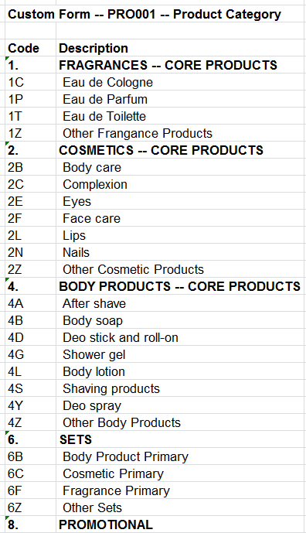
Product Category
Custom Taxonomy
Notes:
DHL, Prochem,

Slide 12
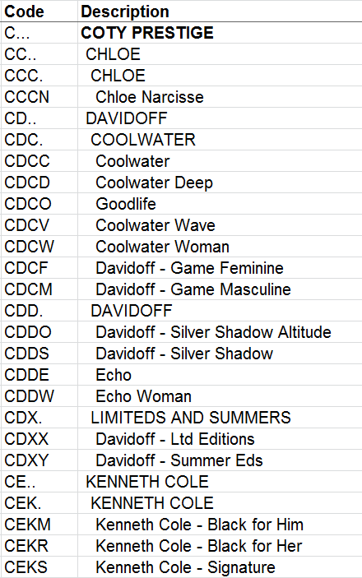
Brand Hierarchy
In the Product Class
Tailored Structured Taxonomy
Notes:
DHL, Prochem,

Slide 13
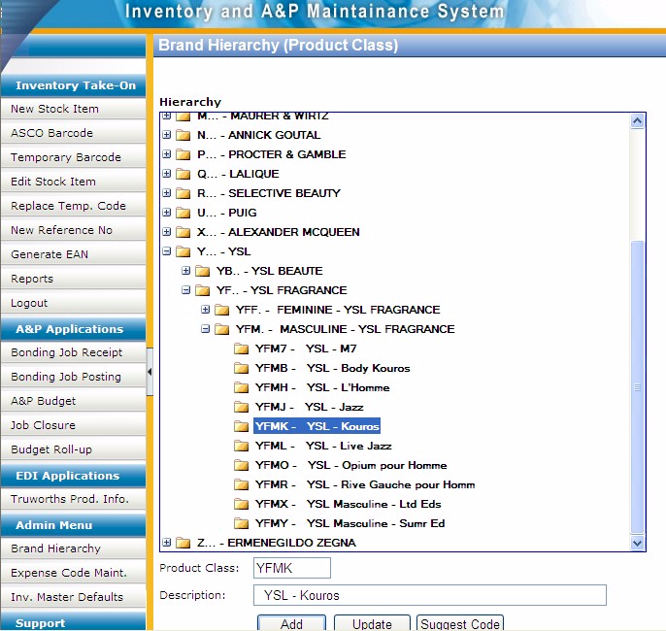
Custom code maintenance
Notes:
DHL, Prochem,

Slide 14
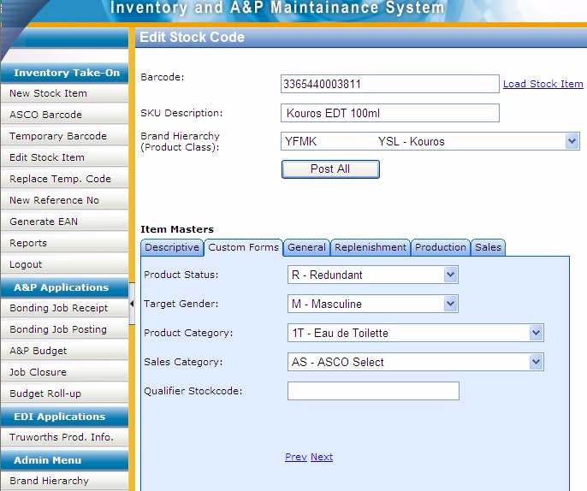
Custom data entry screen with custom taxonomies
Notes:
DHL, Prochem,

Slide 15
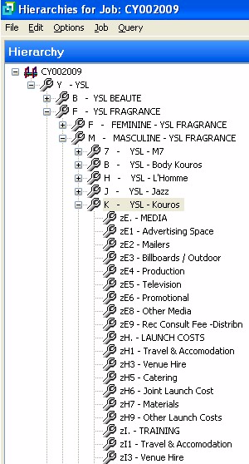
Matching codes in unrelated module provide logical integration
Getting the ERP to do what it supposedly cannot do
Notes:
DHL, Prochem,

Slide 16
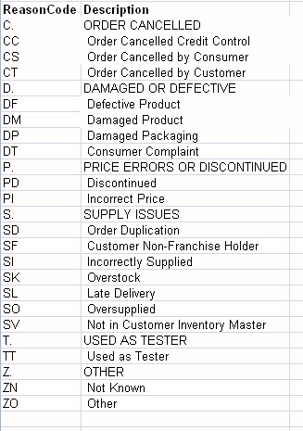
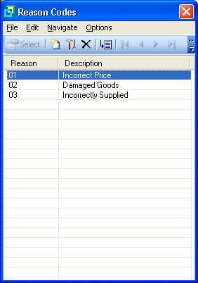
Other attributes redefined
Original Credit Note
Reason codes
Strategically aligned Credit
Note Reason codes

Slide 17
Agenda
ASCO Case Study – Creating Competitive Advantage
Overview of the business
The challenge – overview of the situation before the investment
The opportunity – implementing a new ERP and Warehouse System taking a strategic view
The solution – highly structured Product Class, integration with Projects Module, custom software
The outcome – greatly improved brand management and other capabilities supporting profitable growth and competitiveness

Slide 18
The Outcome
Improved expense allocation accuracy
Detailed ROI analyses
Increased competitiveness
Informed allocation of resources
Facilitated growth
New Distribution Centre a business necessity
Developed a highly analytical culture
Positioned ASCO as an industry leader in the management of information and therefore Brand Management in its category

Slide 19
The Outcome
Practices and ways of working (Processes) have changed and evolved in response to the new capability in an organic internally led manner
Flow from the improved decision making capabilities

Slide 20
Summing up
High level of Executive Custody (Robert)
High level of Strategic Facilitation (James)
Focus on creating a “strategic weapon”
Highly structured precision configuration
Limited scope business specific custom software leveraged the value potential of the configuration
Very substantial strategic benefits in terms of Supplier Satisfaction, competitive advantage and analytical ability
Have assisted ASCO to achieve significant growth

Slide 21

If you do not act within 48 hours you probably never will (Bill Gates)
Act TODAY! ☺
What is your single most important insight from this presentation?
What is the single most practical action that you can take tomorrow to apply strategic (right thing / essence thinking) more effectively?
Please write down your thoughts
NOW

Slide 22
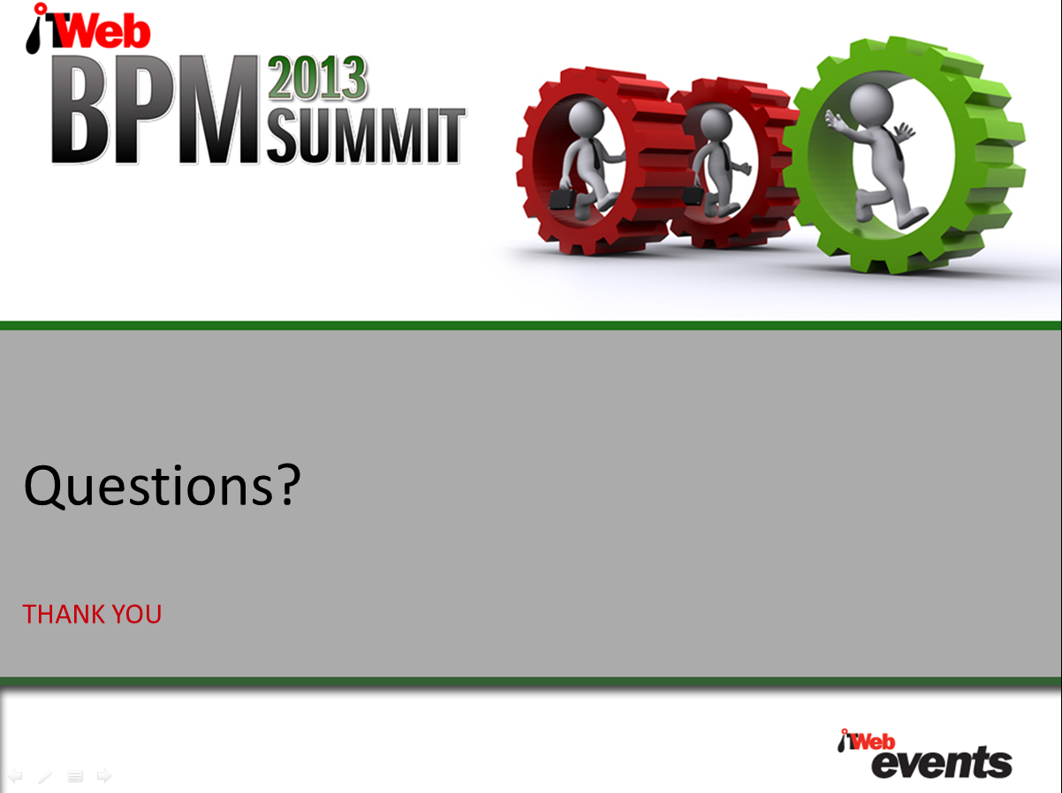
RobertP@asco.co.za
James@JamesARobertson.com

